Slide 1

Department of computer science mitwpu peace university,pune
Presented By
Pragati umate(CSE)
1032202226

Slide 2

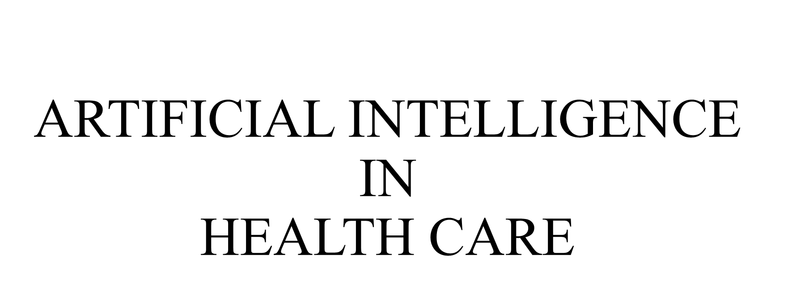
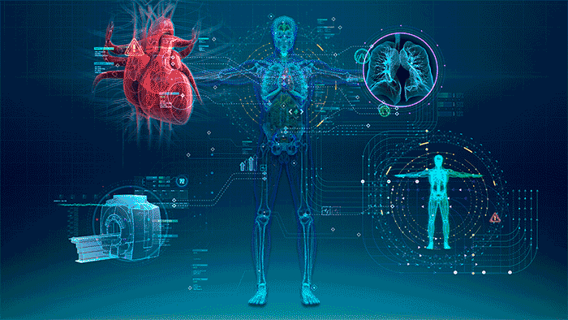

Slide 3
contents
What is AI?
Examples of AI
Introduction to AI in healthcare
Applications of AI in healthcare
Disease Diagnosis and Prediction
Limitations
Conclusion
References

Slide 4
What is Artificial intelligence?
Artificial Intelligence (AI) is branch of science and Engineering.
It deals with smart machines that are capable of performing tasks that normally require human intelligence.
It mimics human cognitive functions.
AI contributes high accuracy, better decision making ,solve complex problems and manage data.

Slide 5
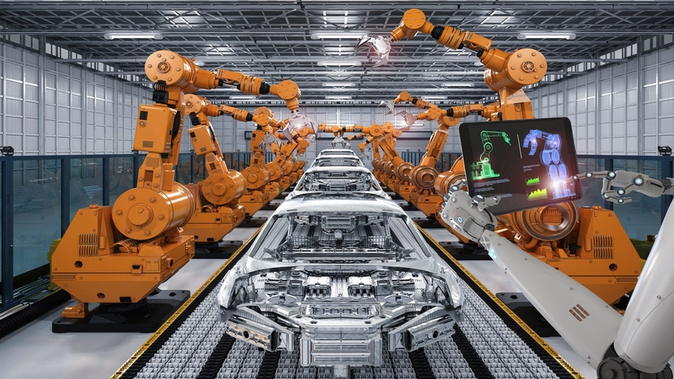
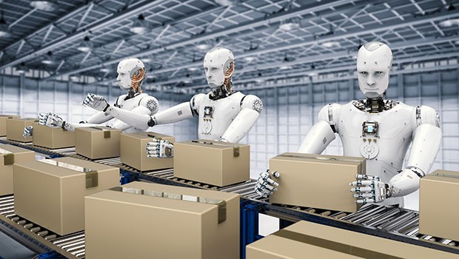
Examples of artificial intelligence
AI in Factories-

Slide 6
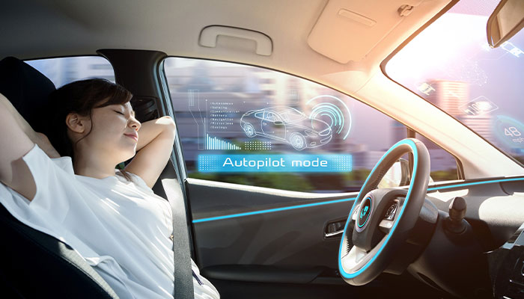
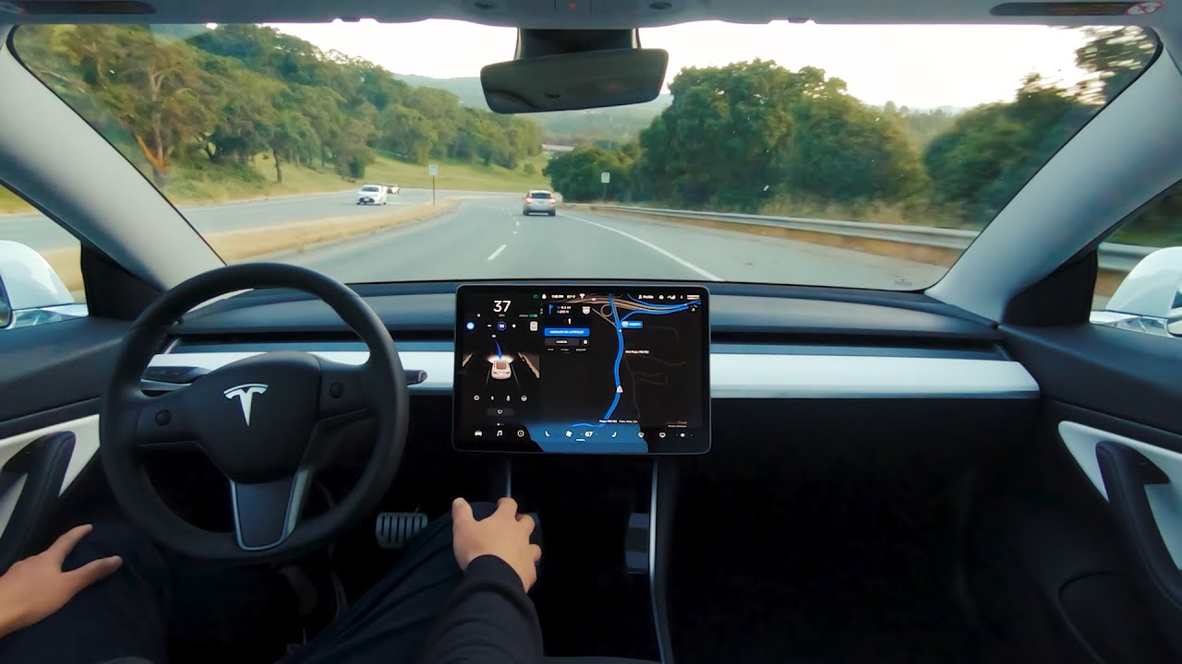
Examples of artificial intelligence
AI in self driving cars-

Slide 7

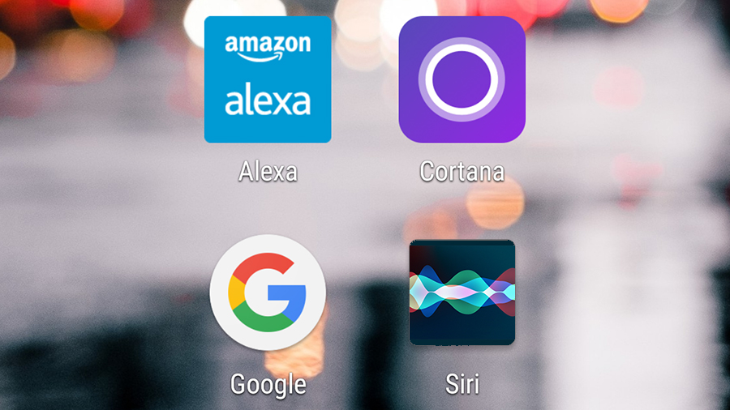
Examples of artificial intelligence
AI in voice assistant-

Slide 8
Introduction to AI in health care
AI involves a system that consists of software, hardware and algorithms.
Artificial Neural Network(ANN) can be used for executing these AI algorithms.
ANN is same as human brain interconnected with network of neurons & can generate output according to different inputs from environment.
Researchers have built NNs that can do supervised learning, unsupervised learning, reinforced learning.
Implementation of NN algorithms can be done by coprocessing CPU and GPU.
NN’s and machine learning together can be utilize in various application in biomedical.

Slide 9
Introduction to AI in health care
AI can helps doctors to evaluate the health endanger of patient and then uses the intelligence to develop quality of care, observe and advice patients.
Using AI arithmetic algorithms and data science can help doctors to make diagnosis better.
Quality of service will be enhanced by implementing AI in healthcare.

Slide 10
Applications of ai in health care
Ai for living assistance
Ai in biomedical image processing
Ai in biomedical research
Disease diagnostics & prediction
Managing medical records
Doing repetitive jobs
Digital Consultation
Drug Creation
Robot assisted surgery

Slide 11
Applications of ai in health care
1.AI for living assistance-
AI can be used to assist living for elderly and disable people.
Neural networks can be trained with specific image processing steps to recognize human facial expression as commands.
By using human machine interfaces based on facial expression with disabilities to control wheel chair without joysticks or sensors attached to body.

Slide 12
Applications of ai in health care
2.Drug creation-
AI can be used in drug and medicine creation as AI can make drug discovery quicker, cheaper and safer.
It can also reduce time.
AI can assist in discovering new compounds used as medicine and can find applications of various new and old drug compounds.

Slide 13
Applications of ai in health care
3. Managing medical data and records-
Data management is the vital role in healthcare, AI can be used for collecting, storing, normalizing and tracing data effectively.
AI allows simulation of smart behavior in a computer system and can increase quality of patient care.

Slide 14
Disease diagnosis and prediction
INPUT
SYMPTOMS
LOAD DATASET
APPLY PREPROCESSING
DISEASE WITH
SYMPTOMS DATASET
DIVIDE DATA
MACHINE LEARNING ALGORITHM
TESTING DATA
TRAINING DATA
LOGISTIC REGRESSION
OUTPUT
PREDICTED DISEASE
RETURN MODEL
PREDICT RESULTS
RETURN PREFORMANCE MARTIX

Slide 15
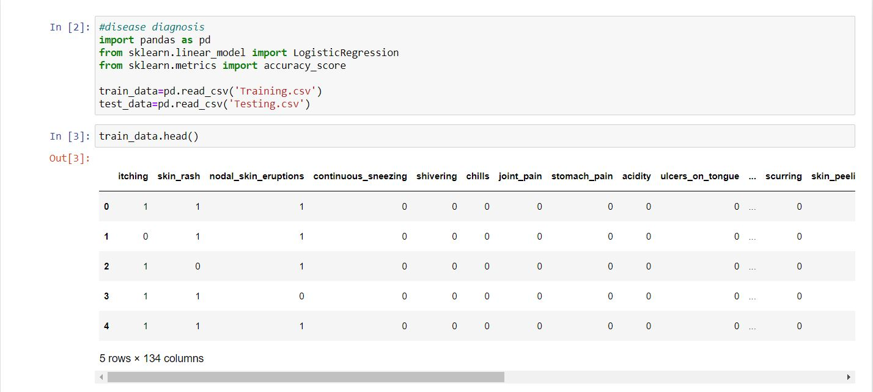
Disease diagnosis and prediction

Slide 16
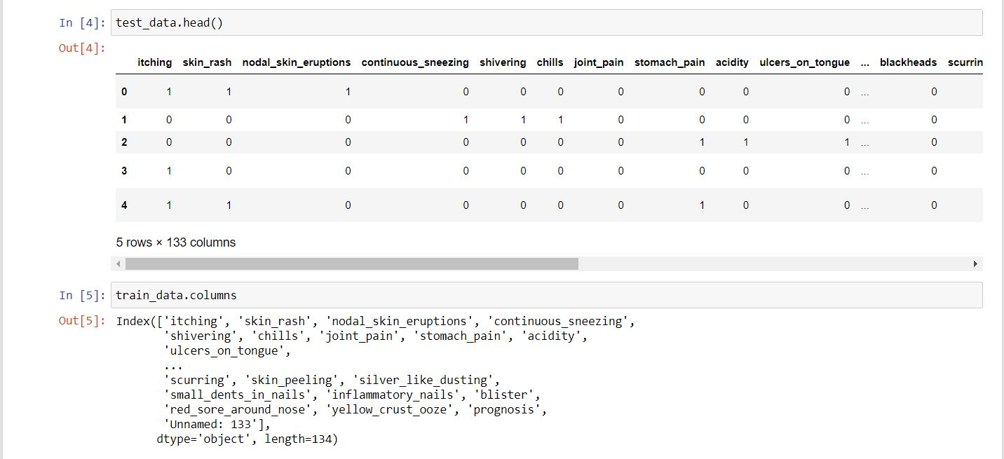
Disease diagnosis and prediction

Slide 17
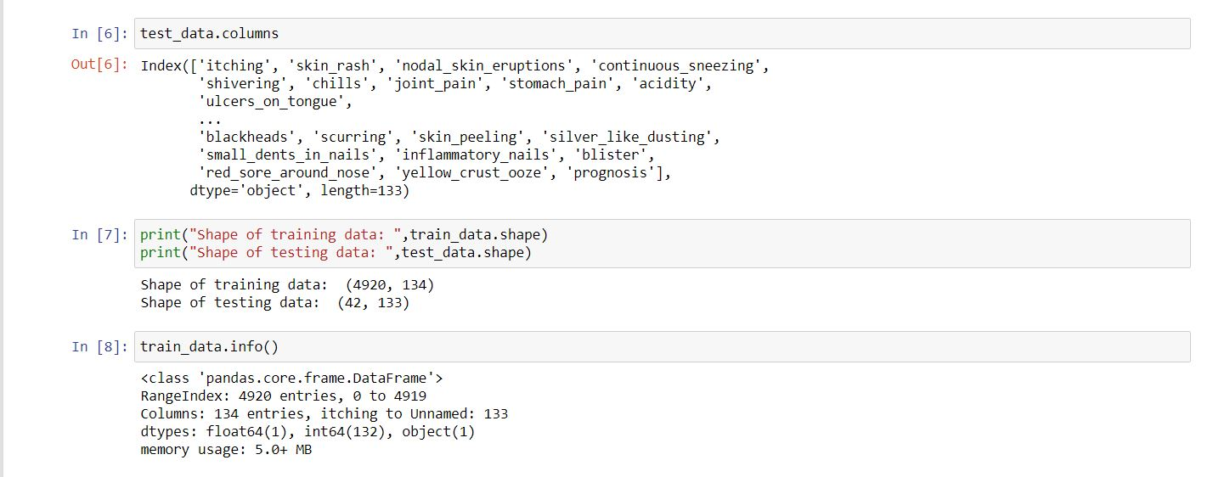
Disease diagnosis and prediction

Slide 18
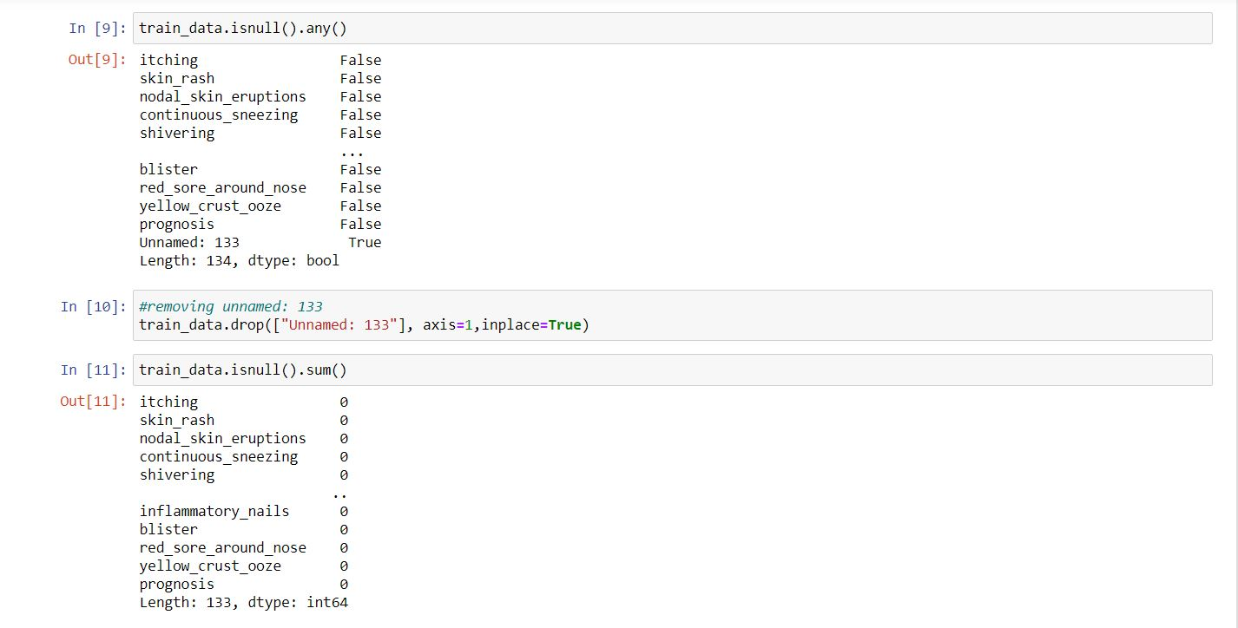
Disease diagnosis and prediction

Slide 19
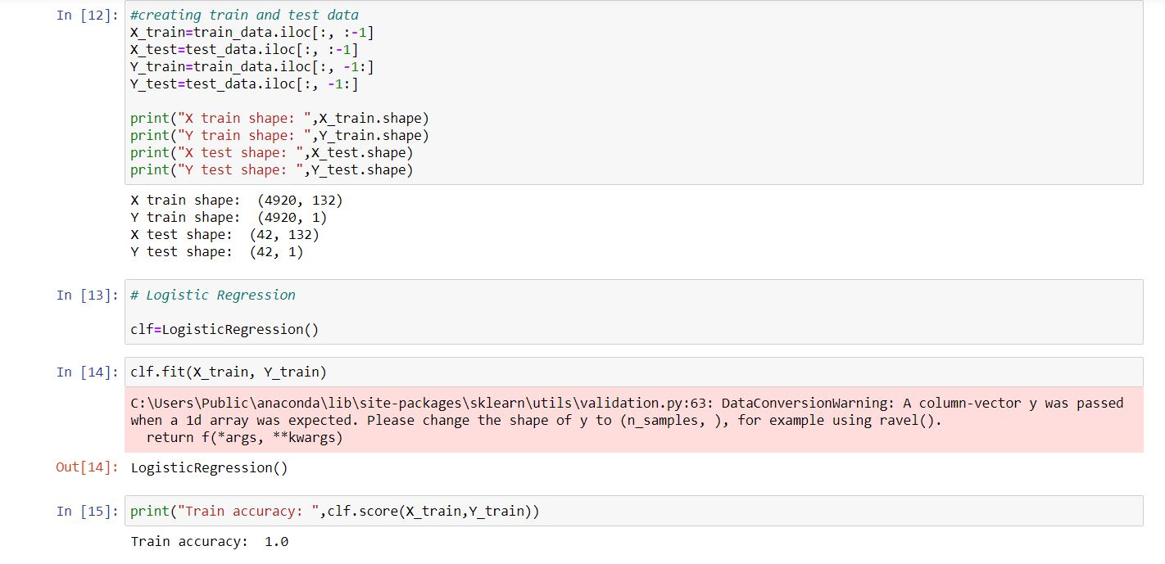
Disease diagnosis and prediction

Slide 20
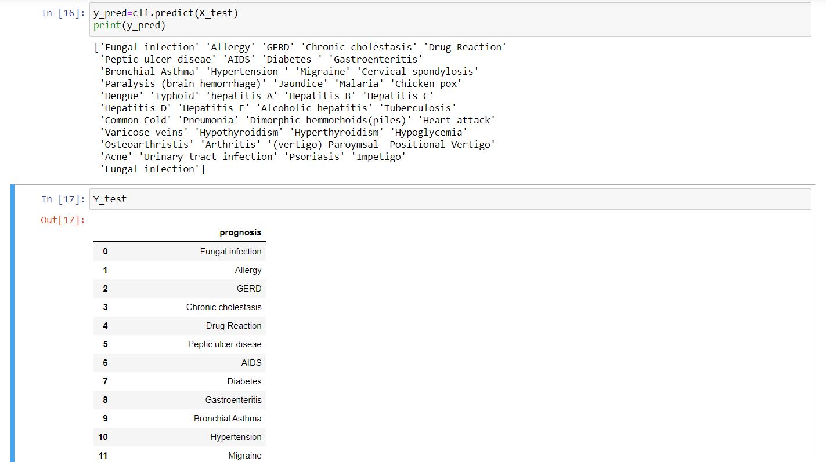
Disease diagnosis and prediction

Slide 21

Disease diagnosis and prediction

Slide 22
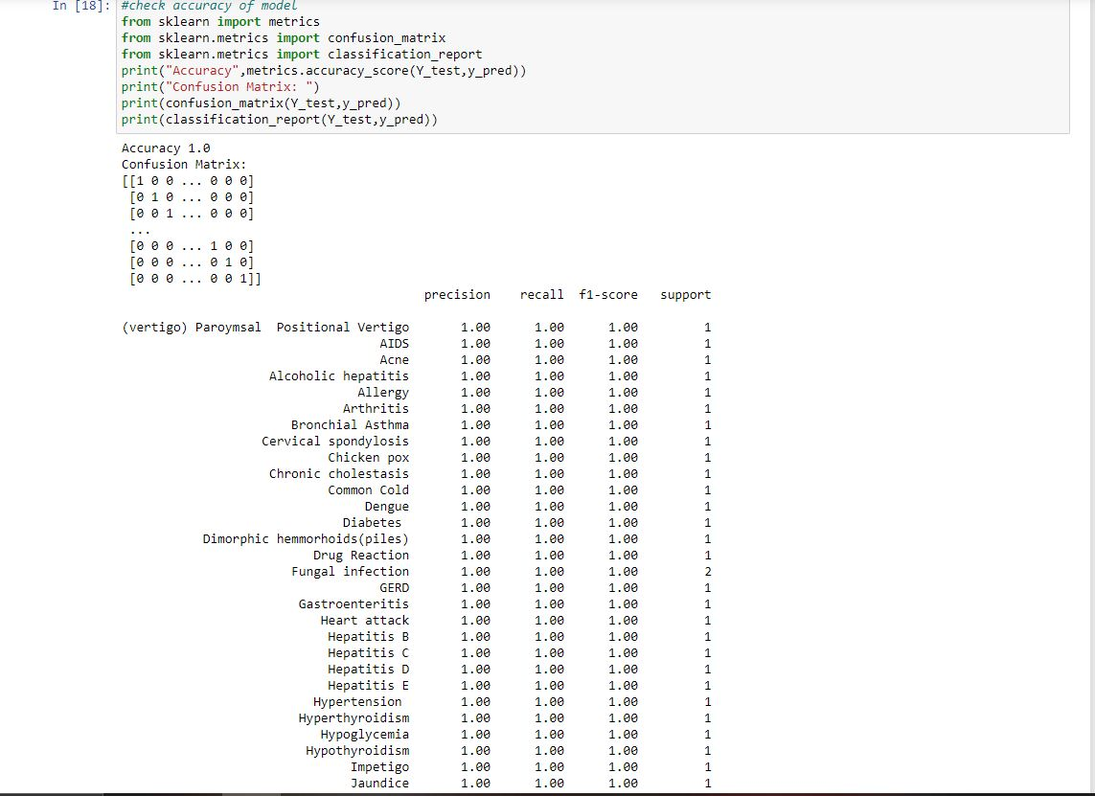
Disease diagnosis and prediction

Slide 23
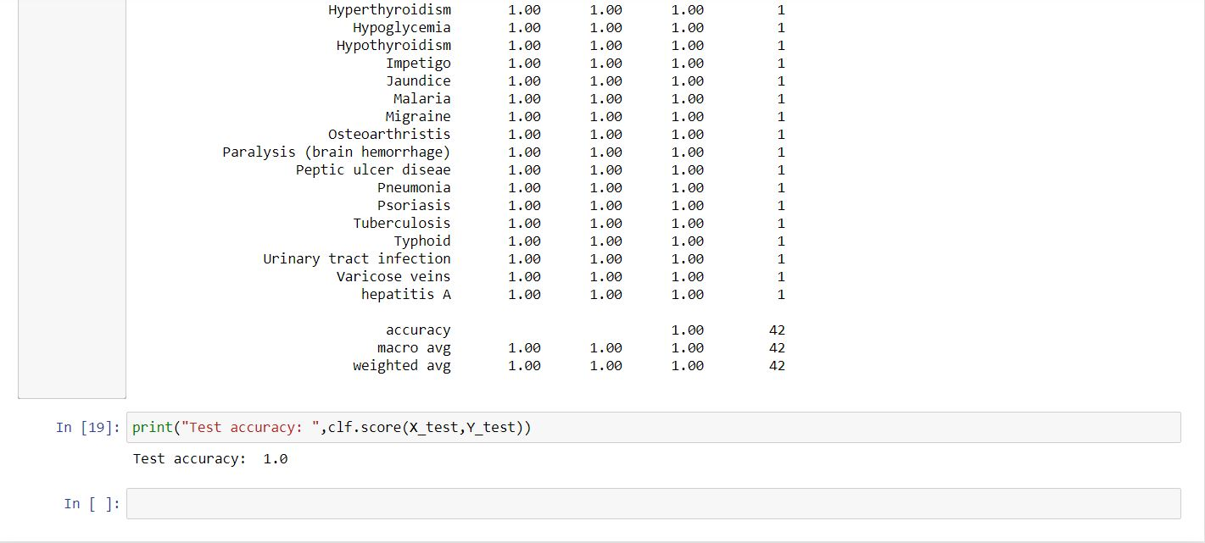
Disease diagnosis and prediction

Slide 24
limitations
Needs Human Surveillance
May lead to unemployment
Inaccuracies are still possible
May overlook social variables
Security Risks

Slide 25
CONCLUSION
Artificial Intelligence is growing science which has applications in various fields as well as in biomedical.
It has wide variety of applications in health care field such as data management, drug creation, etc.
AI has an enormous positive impact for doctors and patient in health care.
As AI has huge capability to collect and analyze a huge amount of various data.
AI could yield quicker and much more accurate diagnoses.
Also it has some limitations like it may lead to unemployment, cannot be accurate always.

Slide 26
REFERENCES
[1] https://www.sciencedirect.com/science/article/pii/S2095809919301535
[2] https://www.researchgate.net/publication/329163470_Artificial_Intelligence_in_Healthcare-A_Review
[3] https://www.ncbi.nlm.nih.gov/pmc/articles/PMC6616181/
[4] https://www.researchgate.net/publication/343304557

